Slide 1
20/11/-1/12/17 9th -10th week

Slide 2
Typical MDO problems
Global or shared variables
Disciplinary or local input variables
State or behaviour variables
An academic example from Sellar R. et. al (2013);
An academic example from Tom Jorquera et.al (2013)

Slide 3
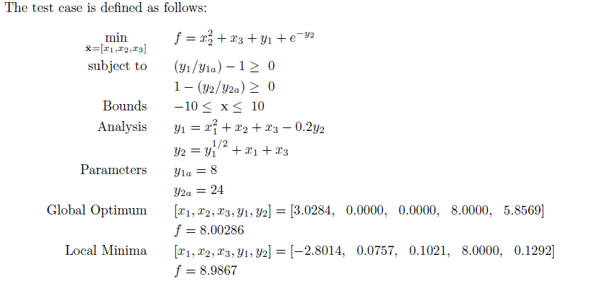
Case 1
An academic example from Sellar R. et. al (2013)

Slide 4
ICO
S
No constraints
Input:
Output:
1
Analysis
Input:
Output:
2
Analysis
Input:
Output:

Slide 5
Results

Slide 6
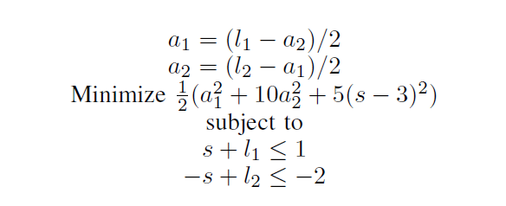
Test case 2
An academic example from Tom Jorquera et.al (2013)

Slide 7
ICO
S
No constraints
Input:
Output:
1
Analysis
Input:
Output:
2
Analysis
Input:
Output:

Slide 8
Results
Global best: -1.8476 1.0120 2.9228 -1.5611 1.2771
F = 9.3372

Slide 9
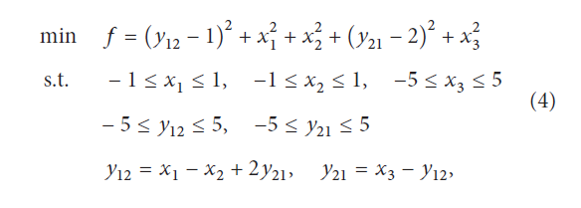
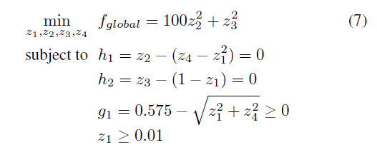
Case 3

Slide 10
Evaluation and Comparison
MDF (All-in-one )
CO;
MCO;
ECO;
ICO;

Slide 11

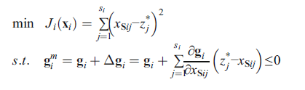
MCO

Slide 12

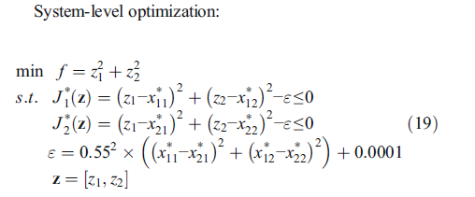
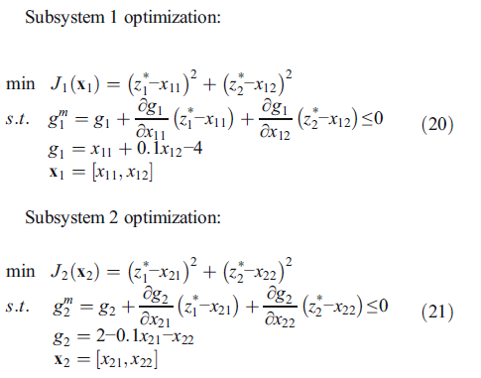
MCO example

Slide 13
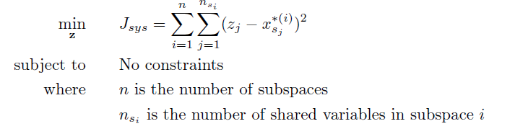
ECO

Slide 14
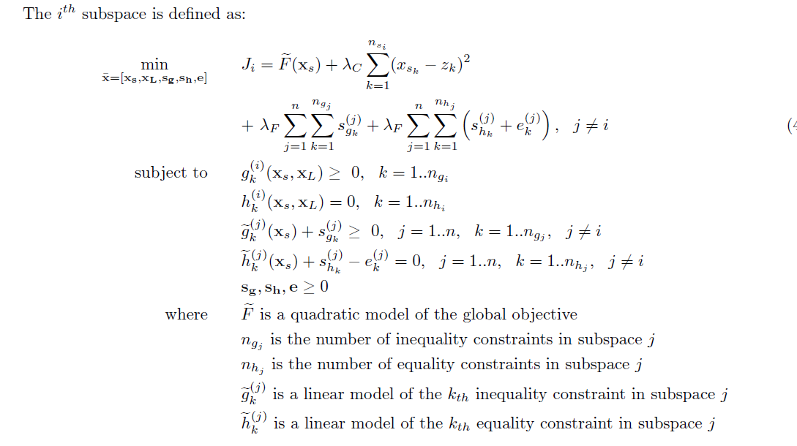
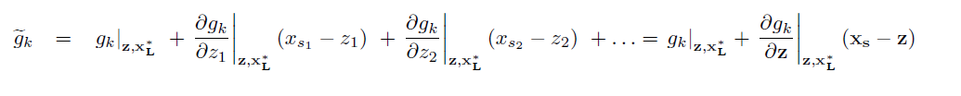

Slide 15
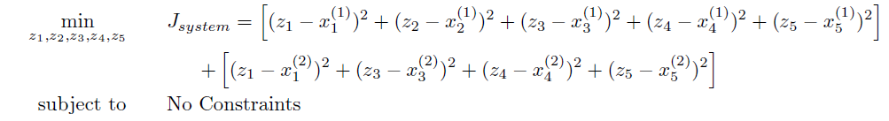
ECO example 1
Academic example of Sellar R.

Slide 16
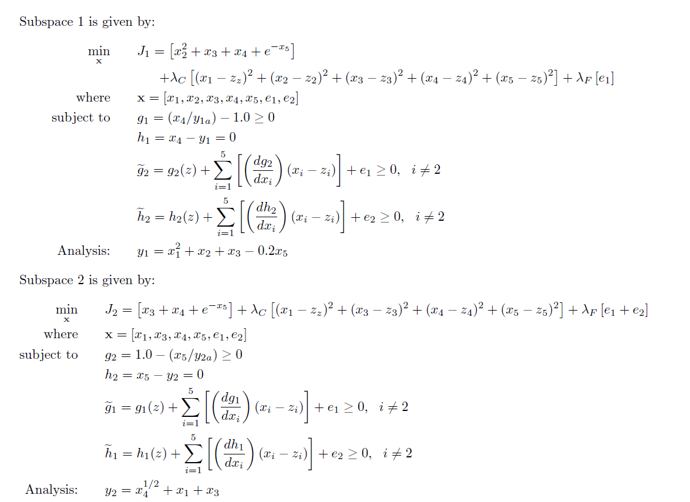

Slide 17
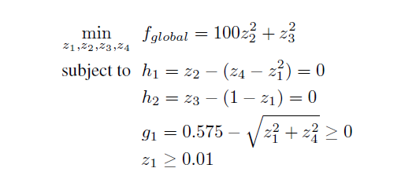
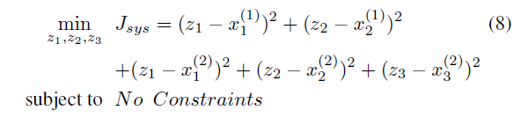
ECO example 2

Slide 18
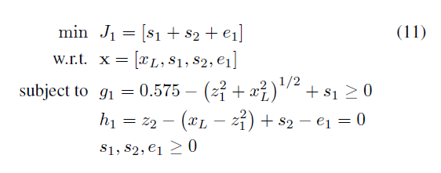
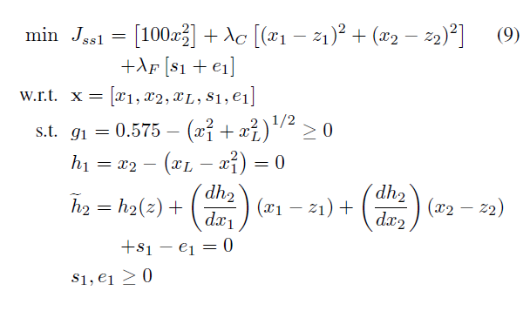
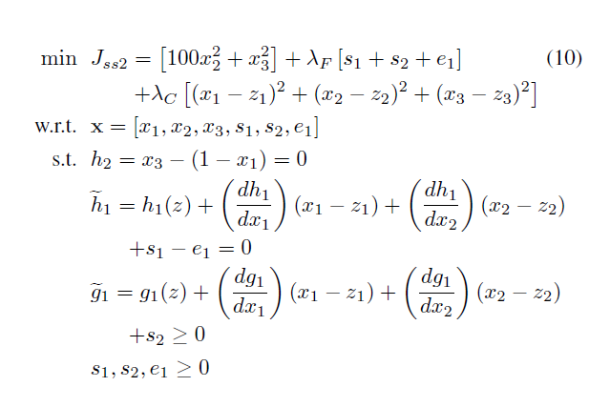

Slide 19
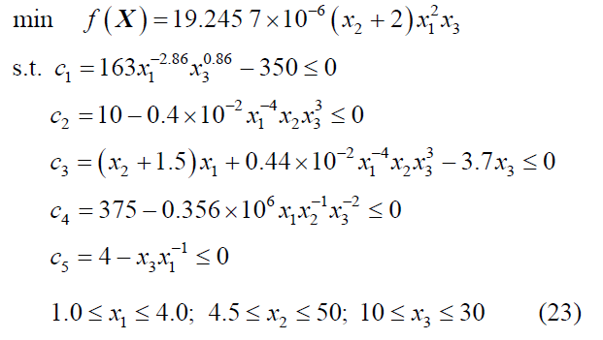
Examples

Slide 20
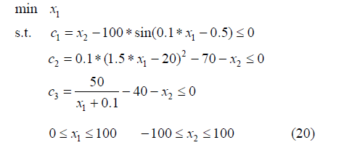

Slide 21
